Slide 1
NF06_EN - Friday Group 7
E-commerce Delivery Management System in C
Anish Patni
Lyudmil Apostolov
Krisha Devannavar
anish_ashwin.patni@utt.fr
krisha.devannavar@utt.fr
lyudmil.apostolov@utt.fr

Slide 2
What the system does
Customer browse a product catalog loaded from a CSV file, build a cart & place orders with a priority level that can be chosen
Administrators process deliveries using a priority scheduling rule and track total revenue and completed deliveries
All orders are managed in memory using two priority queues and a delivery history is saved to a daily log file

Slide 3
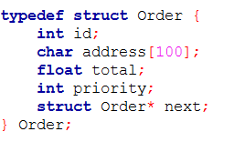
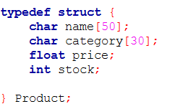
Data structures
All products stored in a fixed array of Product structs, loaded once at startup
Orders stored as a linked list — grows dynamically, no fixed size limit
Two separate queues: one for priority 1, one for priority 2

Slide 4
The Queue System
*** I suggest inserting a diagram of the two queues with arrows showing FIFO direction. A few bullet points is enough per slide

Slide 5
Customer mode

Slide 6
Administrator mode

Slide 7
Demo

Slide 8
Conclusion
Fully functional e-commerce delivery system implemented in C
Priority queue system correctly schedules deliveries across two FIFO linked lists
Product catalog loads and saves dynamically from a CSV file
Delivery history automatically logged to a daily file
Improvements that can be made:
# Write down anything that you feel that could’ve been added etc.

